Slide 1
Forest Cover Type Prediction

Slide 2
Business Problem
Classifying cover type for forest
Predict the actual forest cover type for a given 30 x 30 meter cell
Based on the predominant type of tree in sections of wooded area, given by data elevation, hydrologic, soil, and sunlight , etc
54 attributes/features are given, these attributes contain Binary and Quantitative attributes
Notes:
Understanding forest composition is a valuable aspect of managing the health and vitality of our wilderness areas. Classifying cover type can help further research regarding forest fire susceptibility and de/reforestation concerns. Forest cover type data is often collected by hand or computed using remote sensing techniques, e.g. satellite imagery. Such processes are both time and resource intensive. This project attempts to predict the predominant type of tree in sections of wooded area, given by data elevation, hydrologic, soil, and sunlight , etc.
We have been given a total of 54 attributes/features, these attributes contain Binary and Quantitative attributes, and we need to predict which Forest Cover-Type is it from the given features.
This study area includes four wilderness areas located in the Roosevelt National Forest of northern Colorado. These areas represent forests with minimal human-caused disturbances, so that existing forest cover types are more a result of ecological processes rather than forest management practices
The actual forest cover type for a given 30 x 30 meter cell was determined from US Forest Service (USFS) Region 2 Resource Information System data. Independent variables were then derived from data obtained from the US Geological Survey and USFS. The data is in raw form (not scaled) and contains binary columns of data for qualitative independent variables such as wilderness areas and soil type.

Slide 3
Data Acquisition
Project is based on a famous data set in the machine learning community known as Forest Cover Type available for download in the UCI Machine Learning Repository.
Used the sample data from a competition in Kaggle based on the original data set and separate test set to generate final predictions is used as part of

Slide 4
Data Cleansing
Soil_Type and Wilderness_Area are binary code which are encoded by method one-hot.
Reverse the encoding for EDA and training

Slide 5
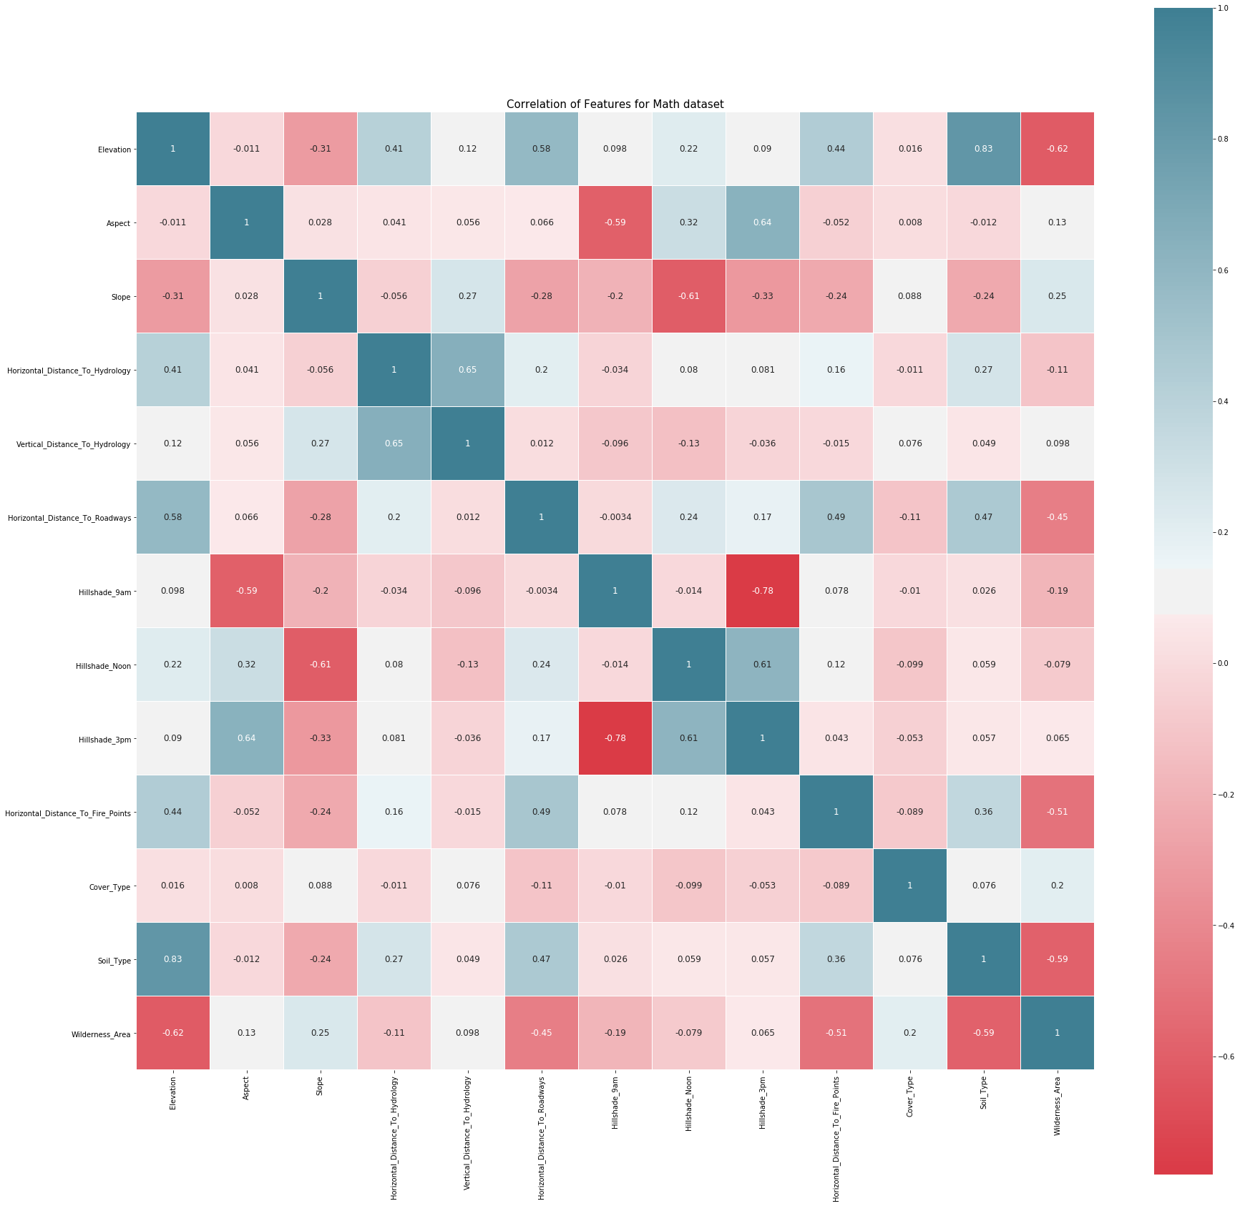
EDA - correlations

Slide 6
EDA - correlations
index | Feature 1 | Feature 2 | Correlation value
5 | Horizontal_Distance_To_Roadways | Elevation | 0.578659
11 | Soil_Type | Elevation | 0.826721
21 | Hillshade_3pm | Aspect | 0.635022
43 | Vertical_Distance_To_Hydrology | Horizontal_Distance_To_Hydrology | 0.652142
55 | Horizontal_Distance_To_Hydrology | Vertical_Distance_To_Hydrology | 0.652142
65 | Elevation | Horizontal_Distance_To_Roadways | 0.578659
99 | Hillshade_3pm | Hillshade_Noon | 0.614526
105 | Aspect | Hillshade_3pm | 0.635022
111 | Hillshade_Noon | Hillshade_3pm | 0.614526
143 | Elevation | Soil_Type | 0.826721

Slide 7
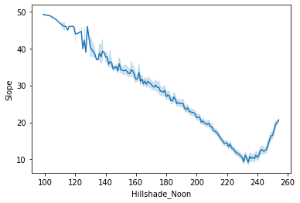
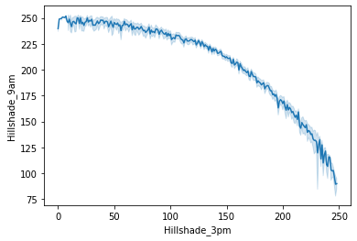
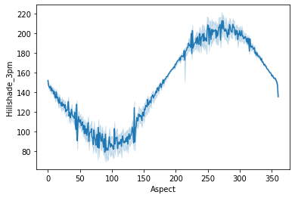
EDA - correlations

Slide 8
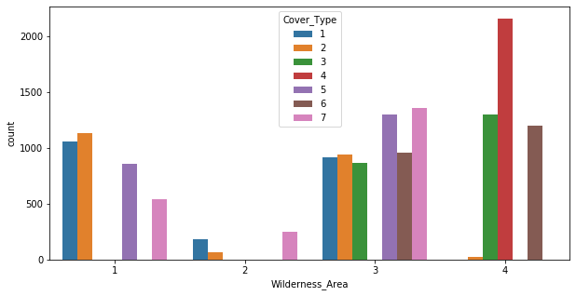
EDA – feature inspection

Slide 9
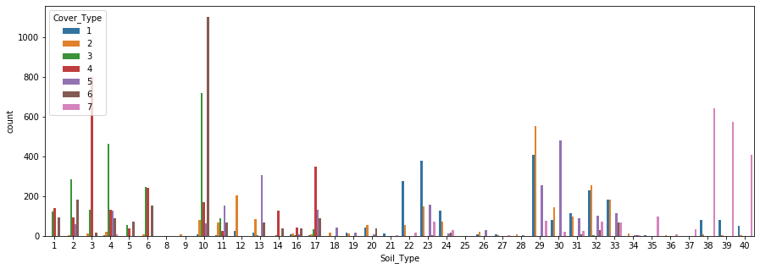
EDA – feature inspection

Slide 10
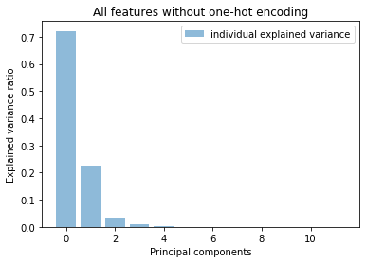
Feature Engineering
PCA
PCA

Slide 11
Feature Engineering
KBest
 | Feature | score | p-value
0 | Soil_Type | 2455.599316 | 0.000000e+00
1 | Wilderness_Area | 1875.559841 | 0.000000e+00
2 | Elevation | 1297.239732 | 4.288061e-277
3 | Horizontal_Distance_To_Roadways | 734.718983 | 1.946781e-155
4 | Horizontal_Distance_To_Fire_Points | 395.568520 | 2.506872e-82
5 | Horizontal_Distance_To_Hydrology | 283.960472 | 2.230028e-58
6 | Slope | 134.755529 | 1.279680e-26
7 | Hillshade_3pm | 69.211195 | 5.933745e-13
8 | Aspect | 61.115932 | 2.669733e-11
9 | Hillshade_9am | 34.122835 | 6.369765e-06
10 | Hillshade_Noon | 18.915569 | 4.308625e-03
11 | Vertical_Distance_To_Hydrology | 11.843630 | 6.554954e-02

Slide 12
ML Algorithm
Classification algorithm
Linear Regression
Train with all features:
 | Algorithm | fold 1 | fold 2 | fold 3 | fold 4 | fold 5 | fold mean
0 | KNN | 0.715939 | 0.821098 | 0.71164 | 0.745701 | 0.854167 | 0.769709
1 | Decision Tree | 0.669643 | 0.750331 | 0.664352 | 0.723545 | 0.788029 | 0.71918
2 | Naive Bayes | 0.54828 | 0.625661 | 0.520833 | 0.652116 | 0.635582 | 0.596495
3 | Extra Tree | 0.533069 | 0.594907 | 0.489749 | 0.583003 | 0.651786 | 0.570503
4 | Random Forest | 0.426587 | 0.525463 | 0.367394 | 0.421627 | 0.530754 | 0.454365
5 | Linear Regression | 0.083664 | 0.309854 | 0.0968915 | 0.087963 | 0.199074 | 0.155489

Slide 13
ML Algorithm
Classification algorithm
Linear Regression
Train with top 4 features in Kbest
['Soil_Type', 'Wilderness_Area', 'Elevation','Horizontal_Distance_To_Roadways’]
 | Algorithm | fold 1 | fold 2 | fold 3 | fold 4 | fold 5 | fold mean
0 | Decision Tree | 0.669974 | 0.664352 | 0.635251 | 0.708664 | 0.732143 | 0.682077
1 | Extra Tree | 0.559854 | 0.575397 | 0.531085 | 0.623016 | 0.621032 | 0.582077
2 | KNN | 0.539352 | 0.488757 | 0.521495 | 0.587302 | 0.561177 | 0.539616
3 | Naive Bayes | 0.354167 | 0.578704 | 0.548942 | 0.614087 | 0.595569 | 0.538294
4 | Random Forest | 0.510913 | 0.543981 | 0.479497 | 0.562831 | 0.571429 | 0.53373
5 | Linear Regression | 0.0687831 | 0.390873 | 0.108466 | 0.0535714 | 0.20172 | 0.164683

Slide 14
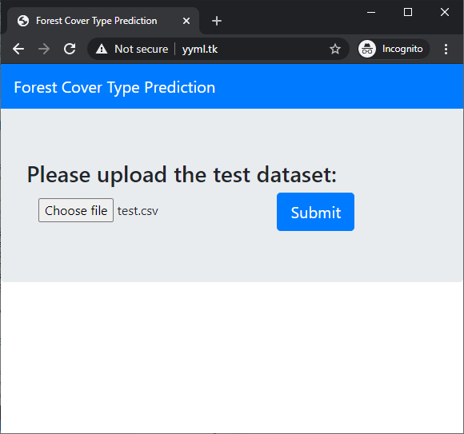
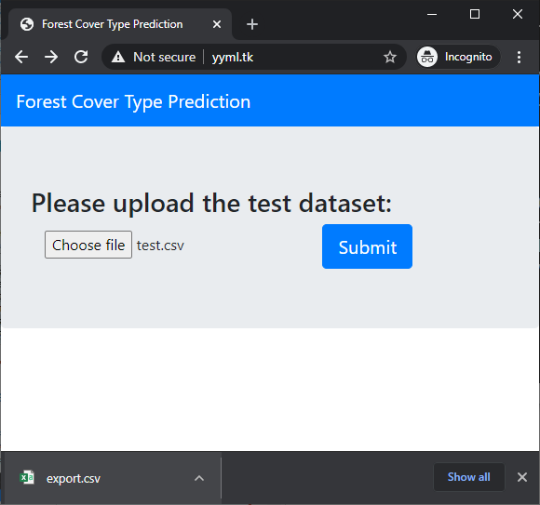
Deployment
Website:
Backend: Flask to predict with saved model with joblib
Frontend: Forms to upload the test dataset, and download the result export.csv.
Demo Link: http://yyml.tk

Slide 15
Thanks

